Slide 1
Predictive Data Mining on Twitter Tweets Dataset
By:
Thilok Reddy Anugu, Sree Chandana Kurella and Vineela Velaga

Slide 2
Contents
Introduction to the DataSet
Predictive Data Mining Techniques
Implementation & Conclusion
Comparisons
Classification Tool
References

Slide 3
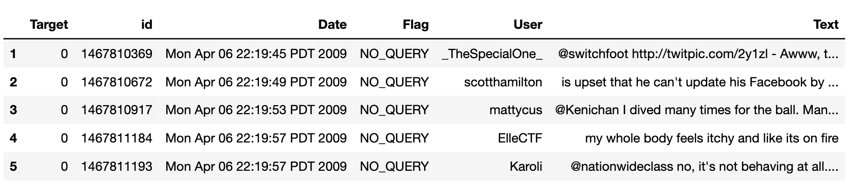
The dataset

Slide 4
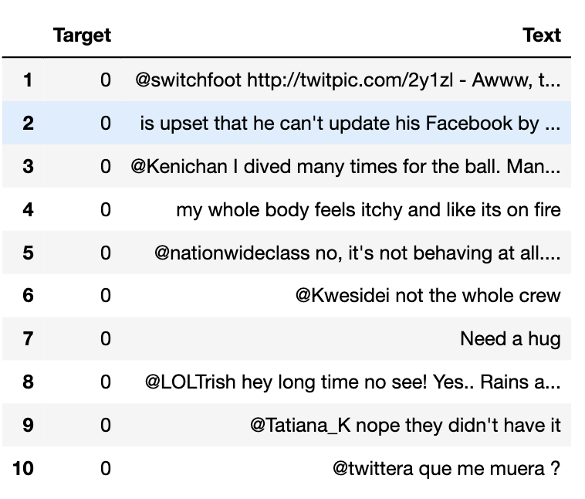
Introduction
The dataset primarily focuses on sentiment in tweets. We chose this dataset because social media text is rich in sentiment, providing a diverse range of expressions.
The main features are the "Target" (sentiment label – 0/4) and "Text" (tweet content).
Sentiment classification helps understand public opinion on various topics, which is valuable for business, policymakers, and researchers seeking insights from social media data.

Slide 5
Predictive Data Mining Techniques
Naïve Bayes
Naive Bayes is computationally efficient, making it suitable for processing a large volume of text data found in tweets.
Fast training speed is advantageous for handling the vast number of tweets in the dataset.
Logistic Regression:
handles more complex relationships in sentiment expression present in tweets.
Suitable for learning intricate relationships between words and sentiment labels.
Decision Tree:
Efficiently handle complex sentiment relationships in tweets.
Utilize a hierarchical structure for detailed pattern recognition.
Adapt to diverse sentiment expressions, capturing both simple and intricate patterns in tweets.

Slide 6
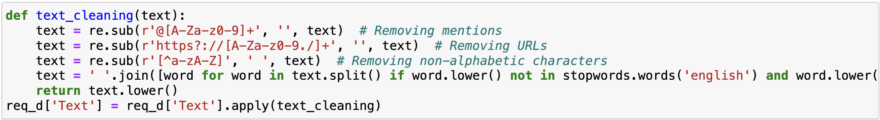
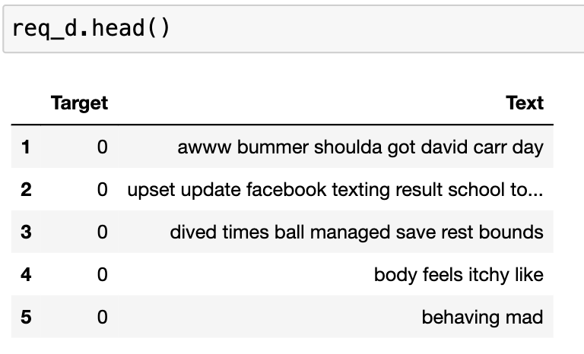
Data Frame for Analysis

Slide 7
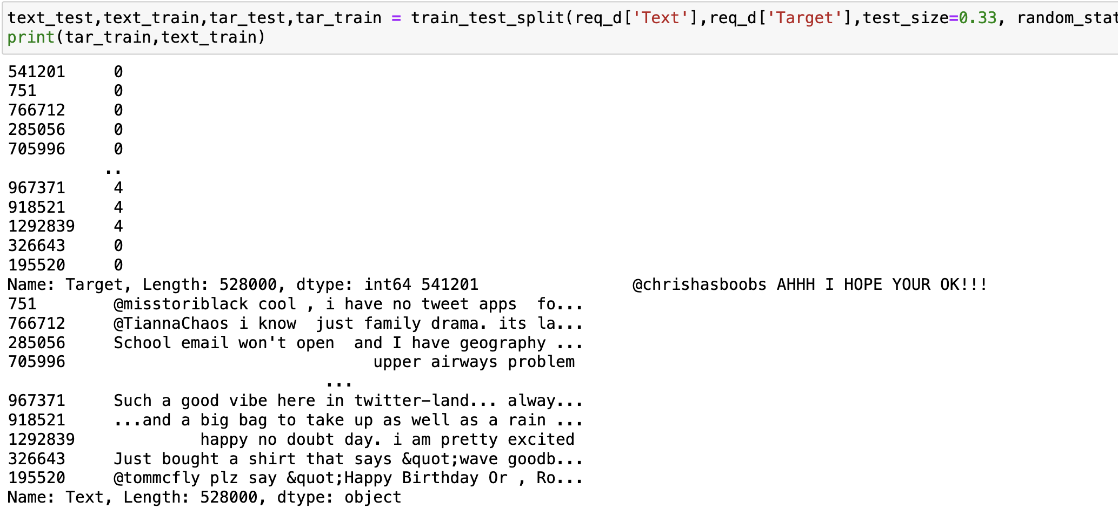
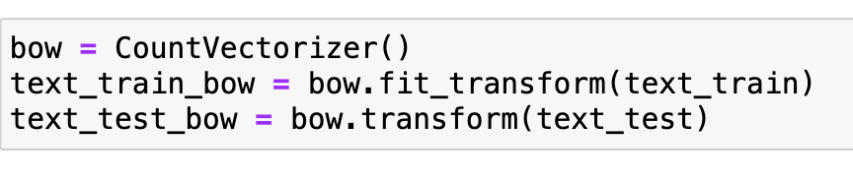
Splitting the dataset into training and testing sets and Feature Extraction

Slide 8
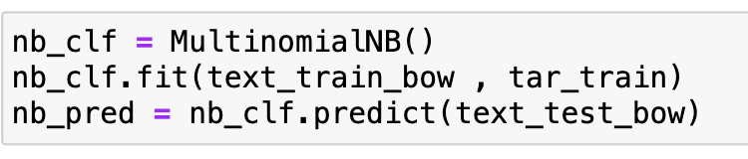
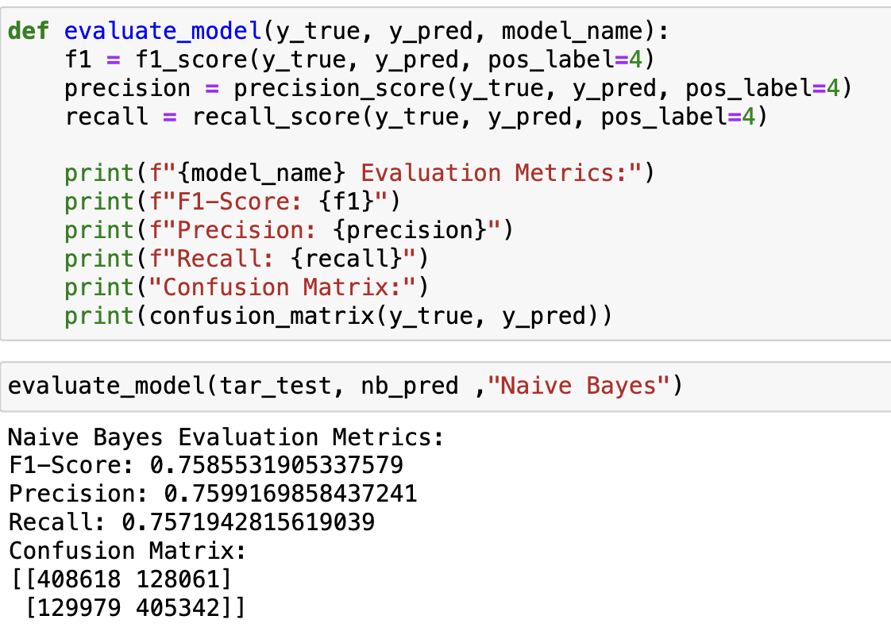
Naïve Bayes
Interpretation:
F1-Score: 0.7585531905337579
Precision: 0.7599169858437241
Recall: 0.7571942815619039
Confusion Matrix:
[[408618 128061]
[129979 405342]]
Provides a balanced performance in identifying both positive and negative sentiments in tweets.

Slide 9
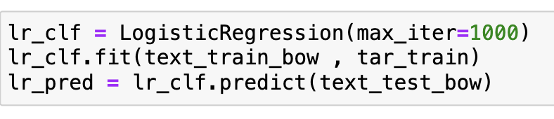
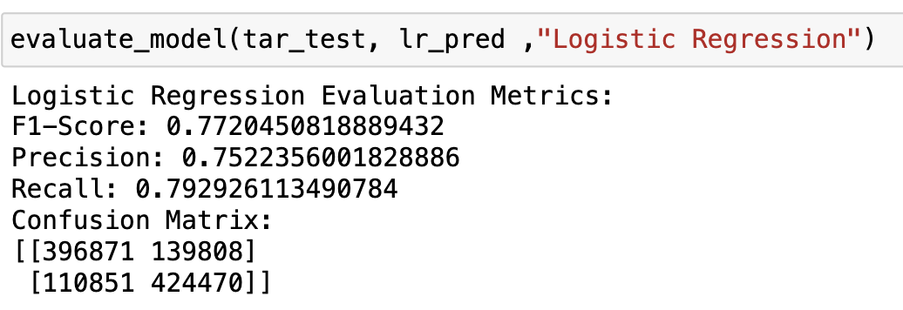
Logistic Regression
Interpretation:
F1-Score: 0.7720450818889432
Precision: 0.7522356001828886
Recall: 0.792926113490784
Confusion Matrix:
[[396871 139808]
[110851 424470]]
The model is effective in identifying positive sentiments while maintaining a good balance with accurate predictions.

Slide 10
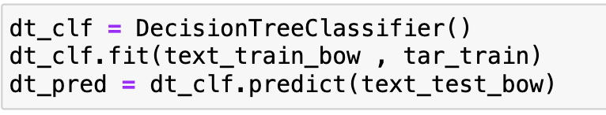
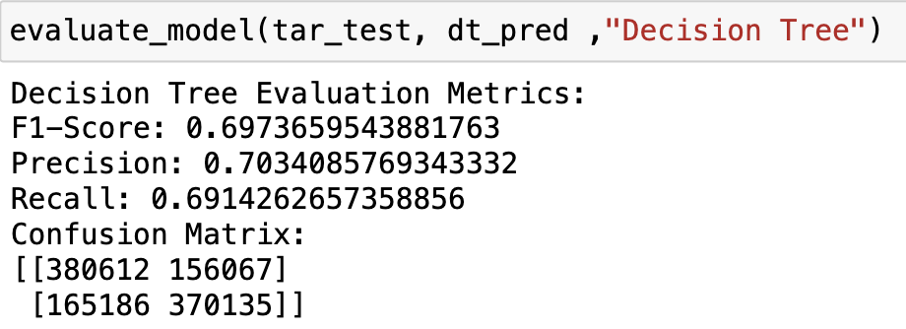
Decision Tree
Interpretation:
F1-Score: 0.6973659543881763
Precision: 0.7034085769343332
Recall: 0.6914262657358856
Confusion Matrix:
[[380612 156067]
[165186 370135]]
The model's performance is satisfactory, but considerations for potential improvements or comparisons with other models may be explored based on specific goals and requirements.

Slide 11
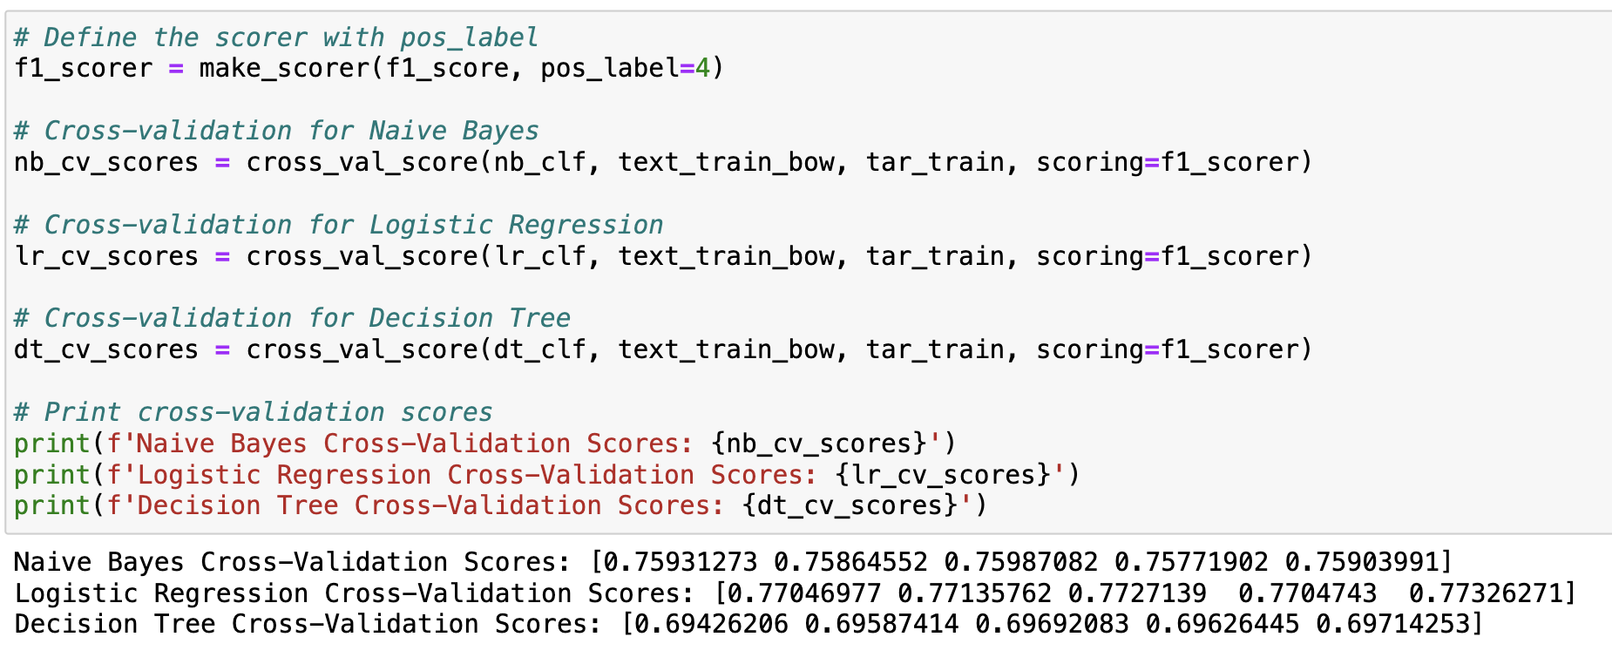
Cross Validation

Slide 12
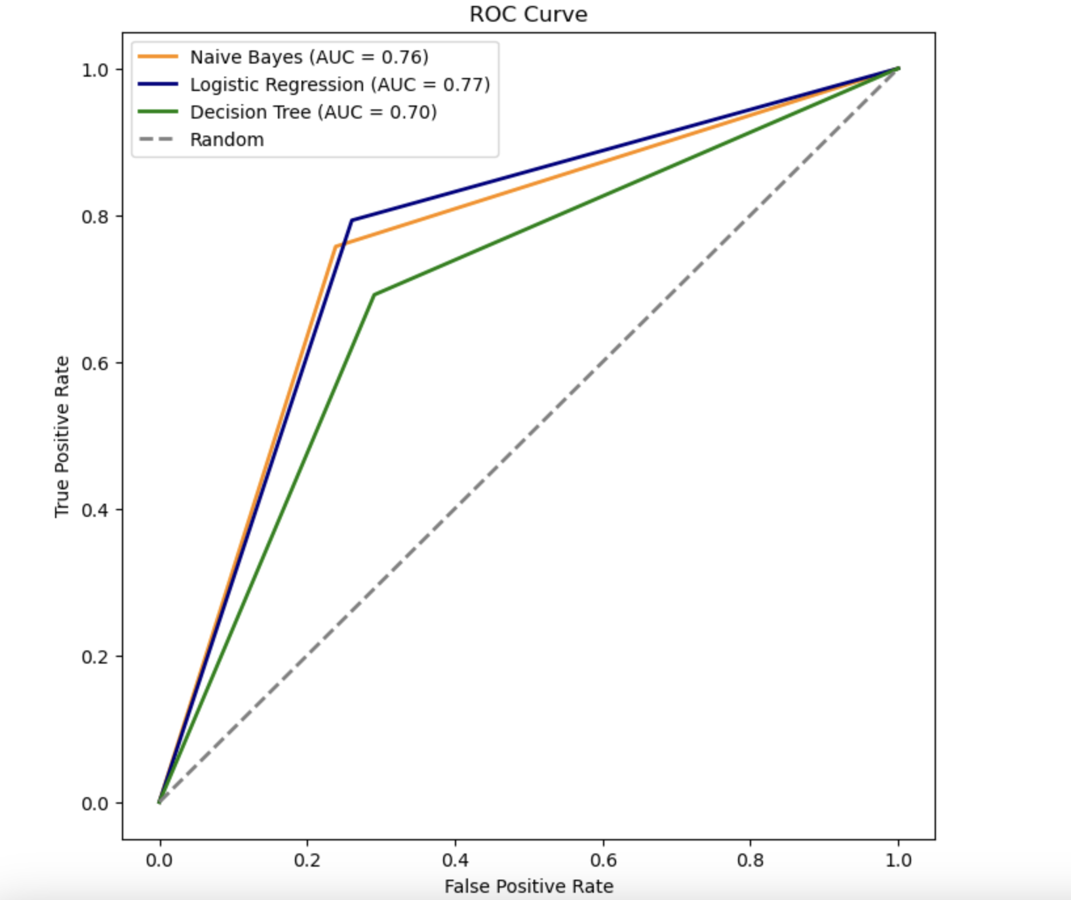
Comparison
LR exhibits the highest F1-Score among the three models, indicating a superior balance between Precision and Recall. This implies that LR is more effective at identifying both positive and negative sentiments.
Decision Tree shows a reasonable F1-Score, precision, and recall. While its performance is satisfactory, it falls slightly behind LR in terms of overall effectiveness.
Naive Bayes reaches asymptotic faster and requires less computational expense compared to LR and Decision Tree.
LR stands out as the top-performing model in this sentiment analysis task, followed by Naive Bayes and Decision Tree.
Logistic Regression's ROC have more Area Under the Curve(AUC). That implies it is better at classifying this dataset.

Slide 13
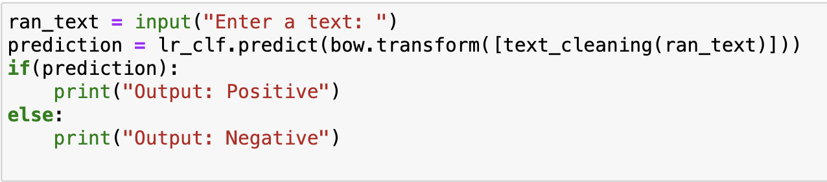
Classification Tool
The tool employs a Logistic Regression model trained on a dataset for sentiment classification.
Logistic Regression is chosen for its effectiveness in handling complex relationships in sentiment expression.
This tool is designed for quick sentiment analysis of user-provided text.
The Logistic Regression model predicts the sentiment label (positive or negative) based on the input text.

Slide 14
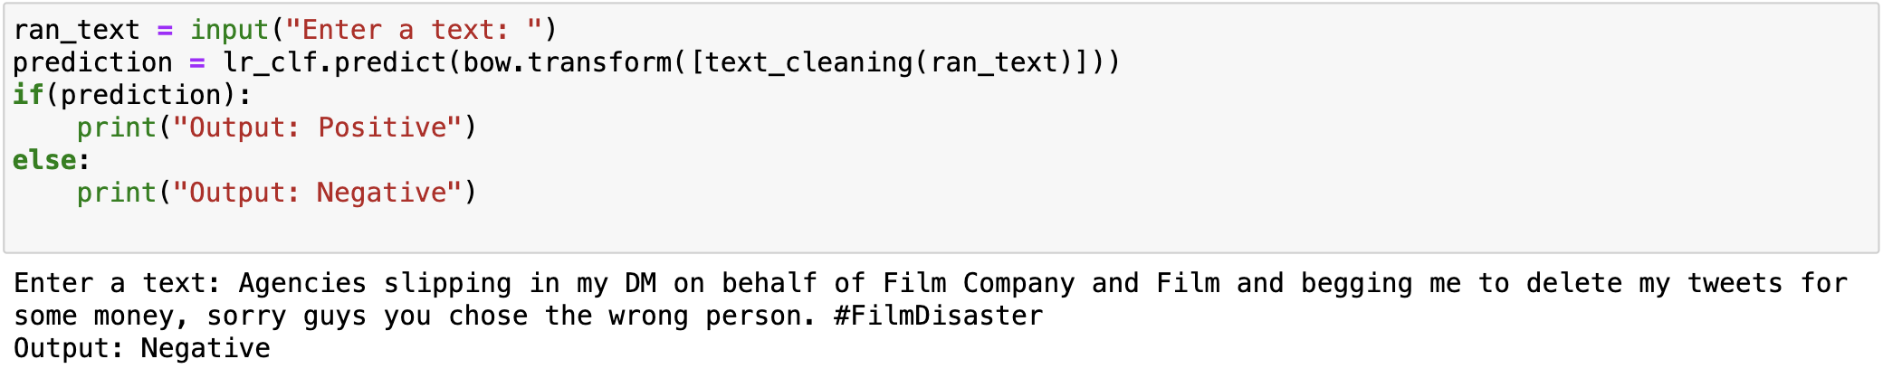
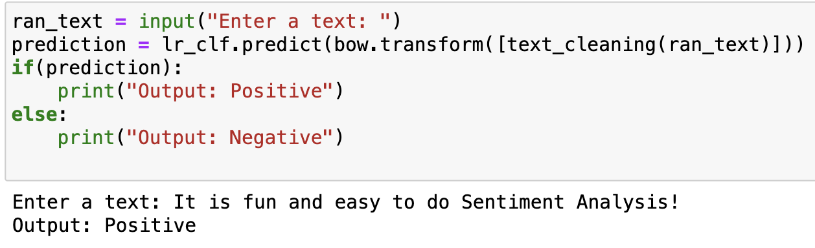
Inputs/Outputs

Slide 15
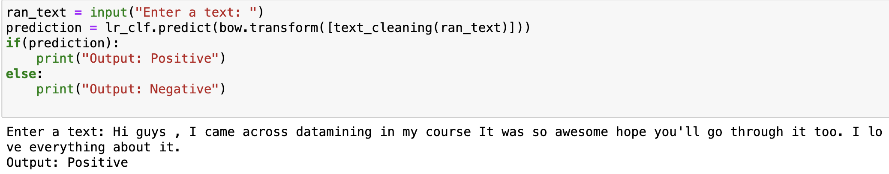
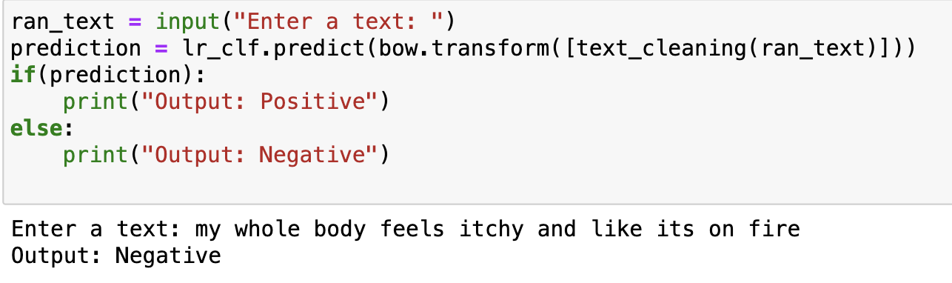
Inputs/Outputs

Slide 16
References
DataSet: https://www.kaggle.com/
https://docs.python.org/3/library/re.html
https://scikit-learn.org/stable/modules/generated/sklearn.model_selection.train_test_split.html
https://scikit-learn.org/stable/modules/generated/sklearn.feature_extraction.text.CountVectorizer.html
https://scikit-learn.org/stable/modules/generated/sklearn.metrics.roc_auc_score.html
https://scikit-learn.org/stable/modules/generated/sklearn.linear_model.LogisticRegression.html
https://medium.com/@sangha_deb/naive-bayes-vs-logistic-regression-a319b07a5d4c
https://www.geeksforgeeks.org/feature-extraction-techniques-nlp/#
https://scikit-learn.org/stable/modules/generated/sklearn.feature_extraction.text.TfidfVectorizer.html
https://scikit-learn.org/stable/modules/generated/sklearn.model_selection.cross_val_score.html

